Slide 1
Graduate Labour Market
Of Sri Lanka

Slide 2
Introduction
Overview of Higher Education in Sri Lanka
Not a state monopoly
Approximately 20,000 graduates from state universities under UGC annually
About 3,500 graduates from non-state higher educational institutions
Sample Selection
5,000 state university graduates
251 graduates from two non-state institutions
Employment Rates
Overall employment rate: 65.5% for state university graduates, 66% for non-state graduates
Higher employment rates for males (81% state, 76% non-state)

Slide 3
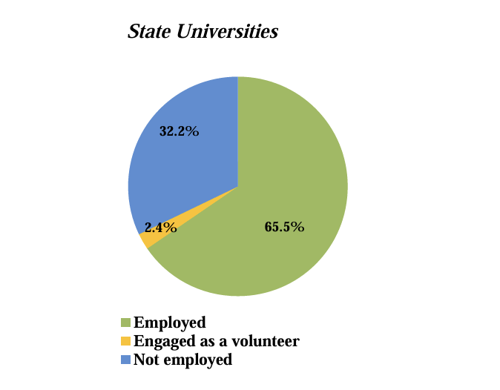
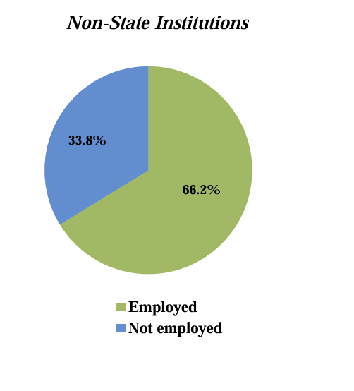
Overall Employment Status
State Sector Graduates
Employed: 65.5%
Engaged as a volunteer: 2.4%
Not employed: 32.2%
Non-State Sector Graduates
Employed: 66%
Not employed: 34%

Slide 4
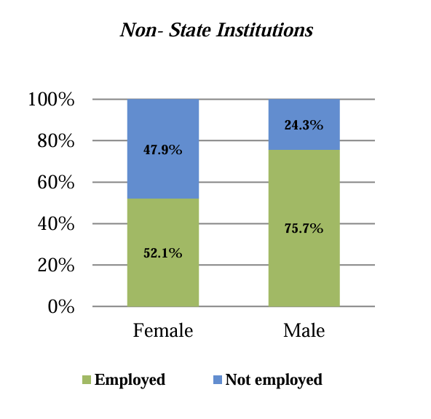
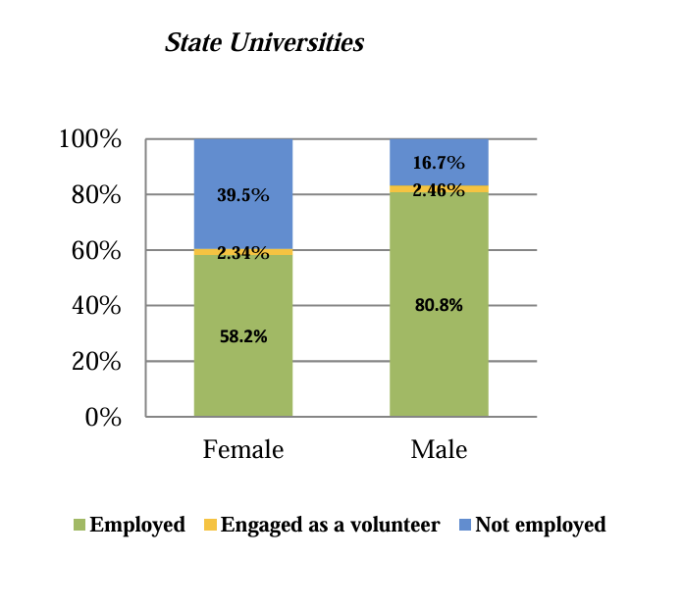
Employment Status by Gender
Promoting Productive Employment for Men and Women Equally
Male : 80.8%
Female : 58.2%
Disparity: 22%

Slide 5
Implications of Gender Disparity
Economic Impact
Inequality in income distribution
Potential hindrance to economic growth
Societal Implications
Reinforcement of gender stereotypes
Impact on overall societal progress

Slide 6
Addressing Gender Disparities
Policy Recommendations
Equal opportunity initiatives
Gender-inclusive employment policies
Corporate Initiatives
Promoting diversity and inclusion
Eliminating gender biases in hiring

Slide 7
Importance of Equal Employment
Global Perspective
Aligning with international goals for gender equality
Economic Development
Contribution of gender-equal employment to overall development
Social Progress
Fostering a society that values diversity and inclusivity

Slide 8
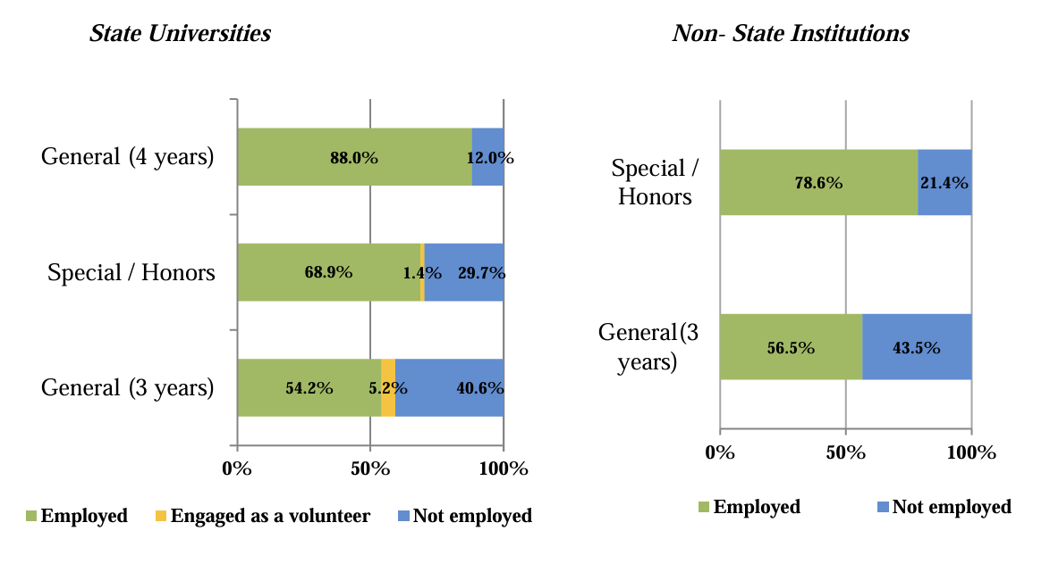
Employment Status by Type of the Degree
Four-Year General : 88%
Special/Honors : 68.9%
Three-Year General : 54.2%

Slide 9
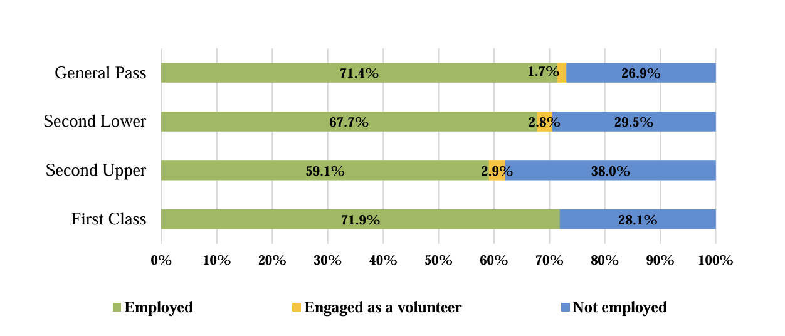
Employment Status by Academic Performance
British tradition, Sri Lankan universities divide the overall performance of graduates into four categories:
First Class: 71.9%
Second Class Upper : 59.1%
Second Class Lower : 67.7%
General Pass: 71.4%

Slide 10
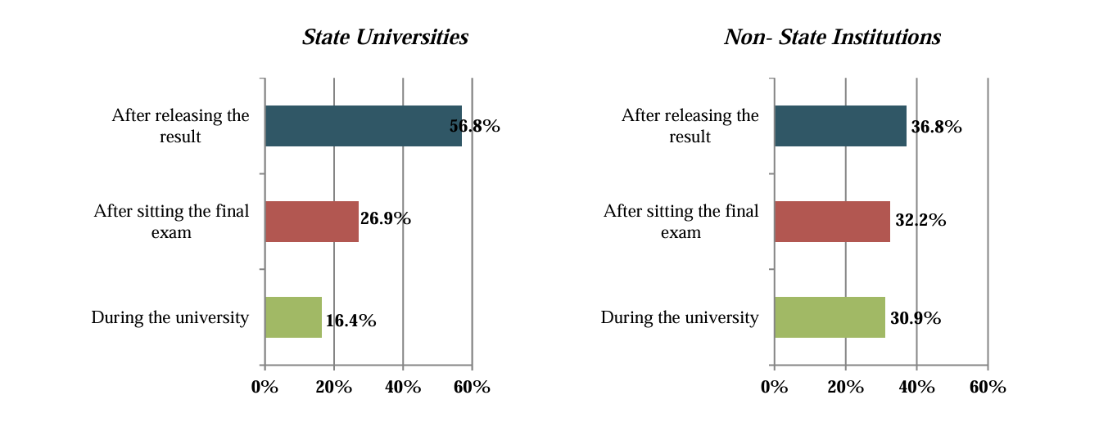
Timing of First Employment
Graduates may find their first employment in one of the following three phases:
During the University career - before the final exam
2. After completing the final exam but before release the final results.
3. After releasing the official results (after graduation)

Slide 11
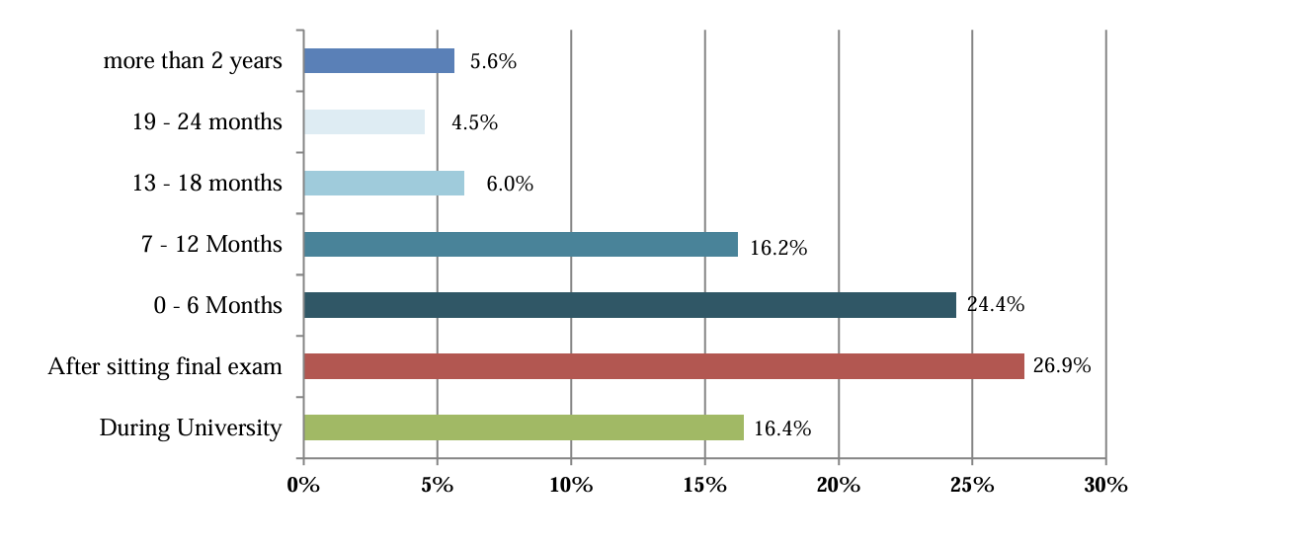
Expanded after releasing results - State Universities

Slide 12
Attributes Relevant to Graduates Employment
Four attributes relevant in improving the employment status of graduates:
Proficiency in english
Level of computer literacy
Availability of internship training during the university
Possession of professional qualifications other than the university degree were examined for their relevance to graduate employment.

Slide 13
Unemployed Graduates
It is a reflection
Multi-faceted socio-economic problems
System of higher education in the country.
Almost 40% of female and 18% of male graduates of the state universities are still unemployed after 2 to 3 years of graduation.
These ratios related to the non-state sector graduates are 48% and 24% respectively.

Slide 14
Major Reasons for Unemployment
Skills mismatch: mismatch between the skills possessed by the graduates and the skills required by the employers from graduates.
Mismatch of expectations between graduates and the employers in terms of employment status: relatively high expectations of graduates may create this issue.
Failure of the economy to create sufficient number of employment opportunities: this is directly related to the level of economic growth.

Slide 15
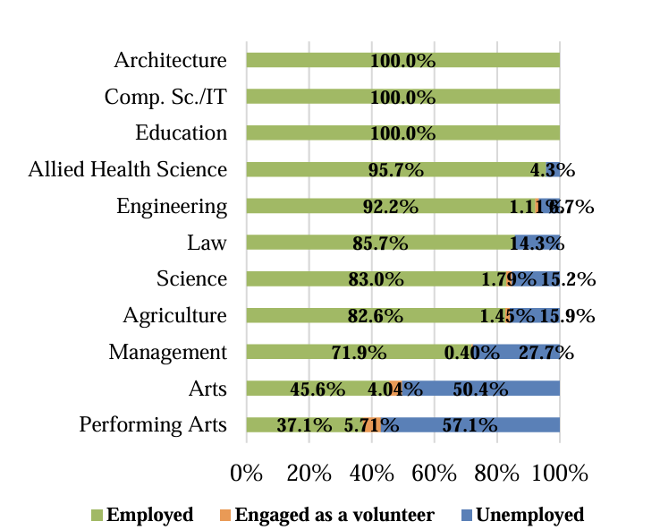
Employment Status by Academic Stream

Slide 16
Other Reasons for Unemployment
Lack of Work Experience
Couldn't find a suitable job
Lack of professional qualifications
Lack of linkage with employers
Waiting for a government job
Continuing further studies
Lack of communication skills
Preparing to start an own business

Slide 17
Recent demographic changes – Sri Lanka
Sri Lanka is experiencing a demographic bonus, with a significantly larger working-age population than children and the elderly.
The share of the elderly population over 60 years old is expected to increase from 12.5 percent to 16.7 percent in 2021. By 2041, one out of every four people is expected to be an elderly person.
Policies that emphasize labor market competitiveness with efficient delivery of services for poor and vulnerable groups can help mitigate the social costs of this demographic transition.

Slide 18
Demographic Transition and Graduate Labor Market
Current Scenario
Service sector contributes 60% to GDP and 40% to employment
Employment rate stands at 56%
Challenges: Low participation and high unemployment among women and youth

Slide 19
Economic changes of Sri Lanka
Sri Lanka’s economic crisis revealed: Over half the population ‘multidimensionally vulnerable,’ says UNDP survey
A United Nations Development Programme survey conducted in 2022 and 2023 found that 55.7% of Sri Lanka’s population, or 12.34 million people, are vulnerable across various dimensions due to the economic crisis.

